Slide 1
INDIA ECOMMERCE SALES PROJECT

Slide 2
Intro
Context:
We want to understand how Amazon India ecom is performing in terms of sales for the months April, May and June and explain ups or downs in revenue.
Datasets:
Orders: order_id, quantity, amount spent, sku, customer type, order status, city.
Products: SKU codes, design numbers, stock levels, product categories, sizes and colors.

Slide 3

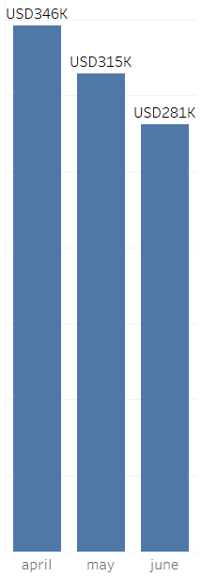


Code
Business Question:
What is the total revenue per month?
Output

Slide 4
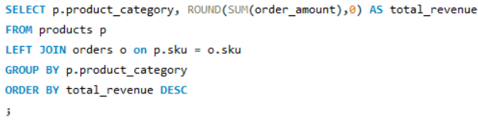
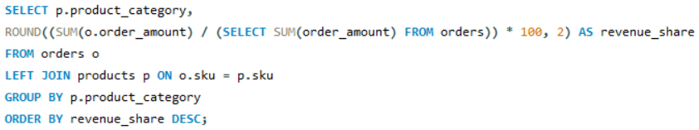
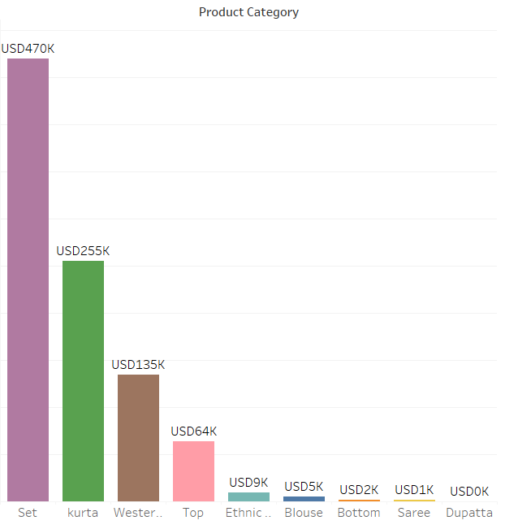
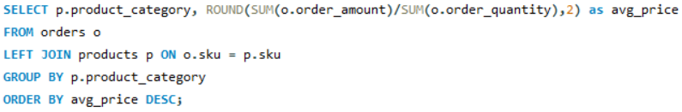
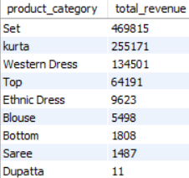
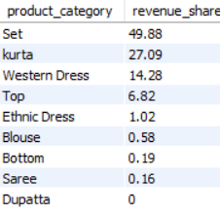
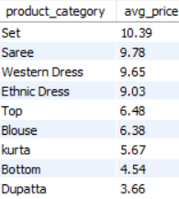
Code
Business Question:
What is the Revenue by Category?
What is the Revenue share by Category?
What is the average price per Category?
Output

Slide 5
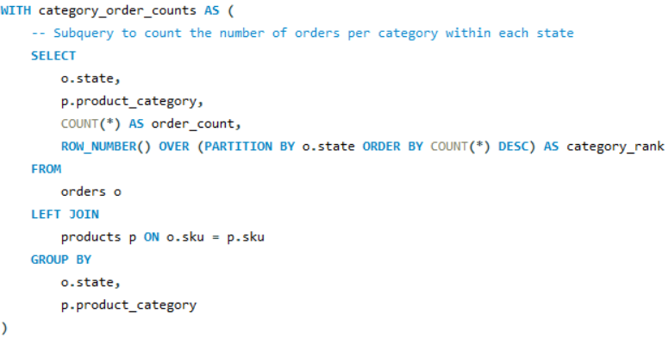
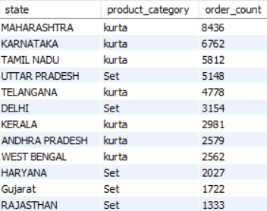
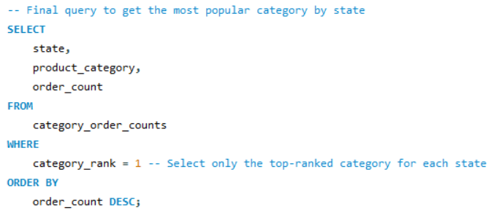
Business Question:
What are the most popular category by state?
Code
Output

Slide 6
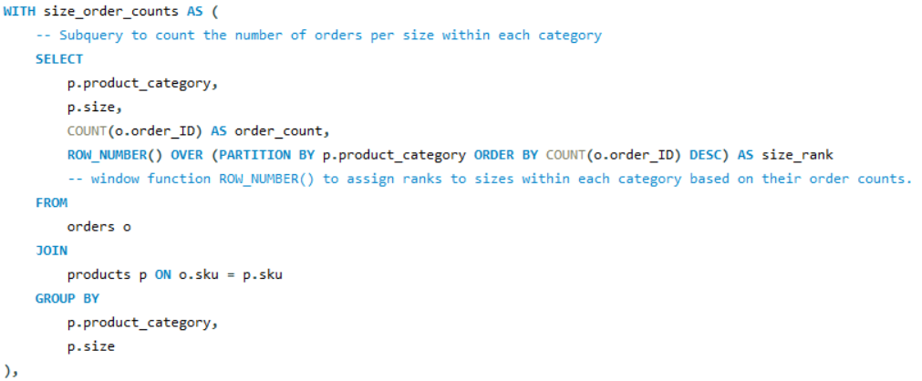
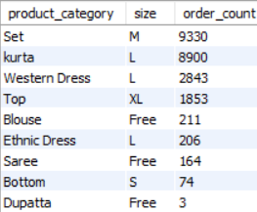
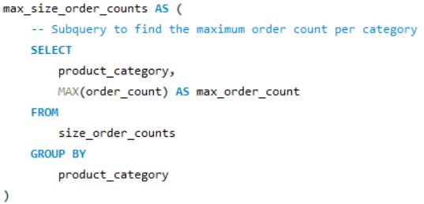
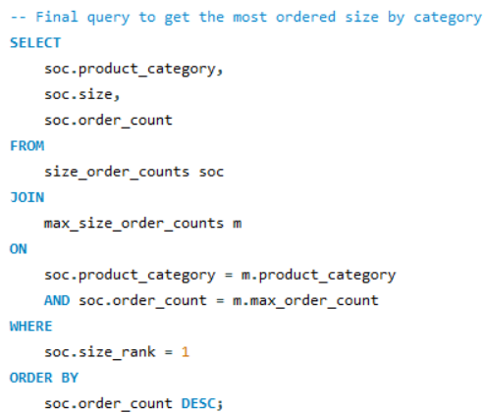
Code
Business Question:
What is the most ordered size by category?
Output

Slide 7

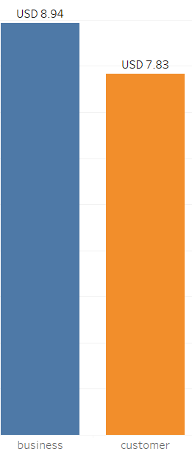

Code
Business Question:
What is the AOV by customer type?
Output

Slide 8
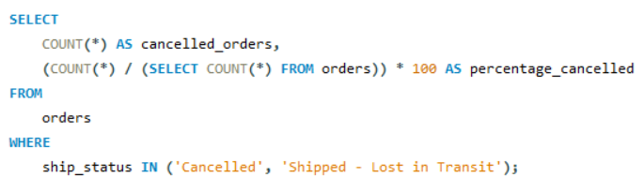
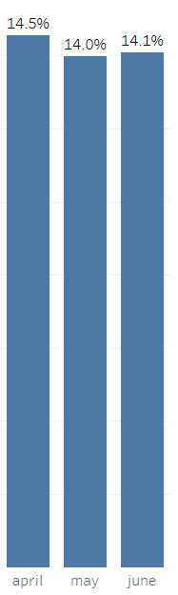

Code
Business Question:
How many orders got cancelled?
Output

Slide 9
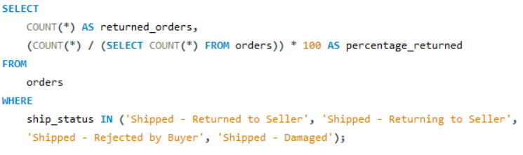
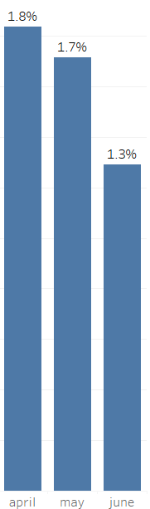

Business Question:
How many orders got returned?
Code
Output

Slide 10
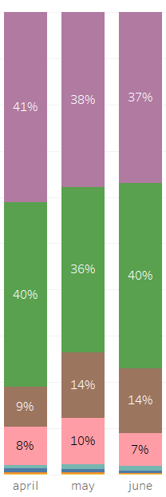
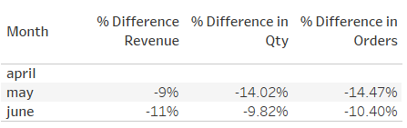
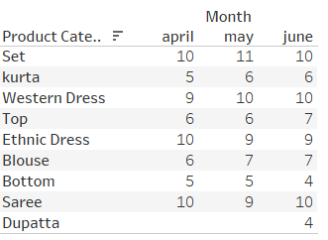
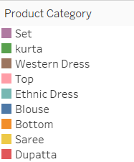
Business Question:
What happened for the revenue to drop?
Units share by category
MoM diff.
Orders faced a drop;
What made revenue show a less of an impact was the category mix change, mainly for the Western Dress increasing its units share and ASP.
ASP

Slide 11

Data Cleaning
NaN values
Convert INR to USD
Drop columns
Renaming columns
Creating Month column
Convert datetime column

